Slide 1
Organic drive
Mahima M Rao
--PES university

Slide 2
Problem Statement
Crisis on the one hand and the malnutrition crisis on the other are related to the fact that food production has become chemical intensive and is focused on “Yield per Acre”
Yield as well production cost is more -- IRONY XD
To produce more yield more is the chemicals used -- primarily , neither is any crisis resolved and soil is destroyed eventually --- what's the point in this blind aspect of agriculture
This ignores the lost nutrition in the displaced biodiversity. Thus the Green Revolution led to increase of rice and wheat with chemical intensive, capital intensive and water intensive inputs

Slide 3
Soil and nutrients
Key factors in soil organic matter balance and soil quality: tillage, biomass input, and soil erosion.
• reduce intensity and frequency of tillage
• grow cover crops to: – maximize biomass – optimize nitrogen (N) dynamics – minimize bare-soil periods – eliminate erosion
Biodiversity based farming for nutrient enrichment in crop production

Slide 4
What is my way to approach this problem
2 main aspects covered :
1)Health per acer : crops suggested considering the nutrient value
All nutrients or any specific
Combinations of crops are suggested in percentage
Current dataset was created considering the experiments already performed
2) Cover crop suggested as per the crop grown -- to enrich soil naturally

Slide 5
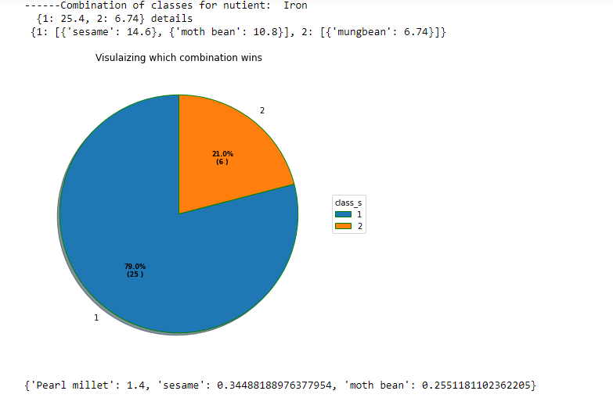
Example 1 : [1,"id2","Pearl millet",2,"Iron",] -- this is looking for iron specifically in nutrients -- these are the cases when iron major crops are needed to be grown

Slide 6
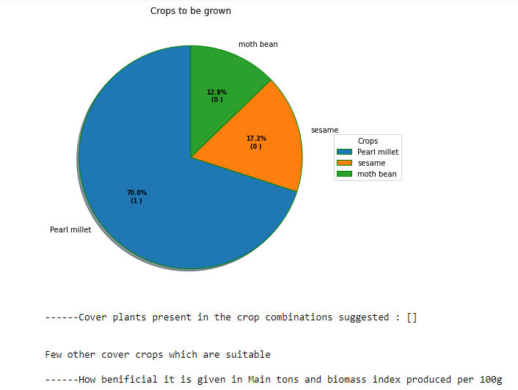
This gives the combination in which the crops to be grown --priority based in discovered combinations

Slide 7
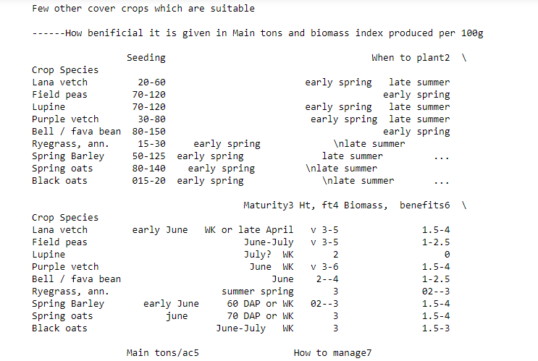
Next soil -- cover plants are suggested taking in crops and season they are grown in -- with some prominent details

Slide 8
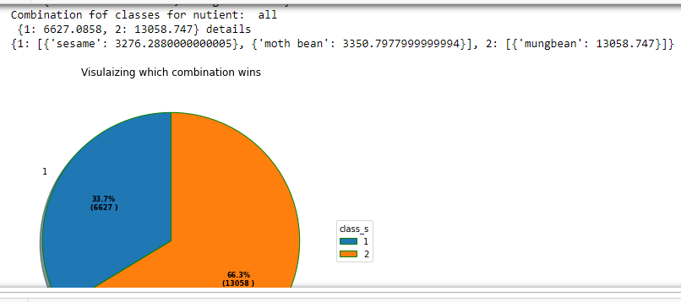
Example 2: [1,"id2","Pearl millet",2,"all",] here considering all nutrients which's better
Here class 2 wins unlike that in Ex1

Slide 9
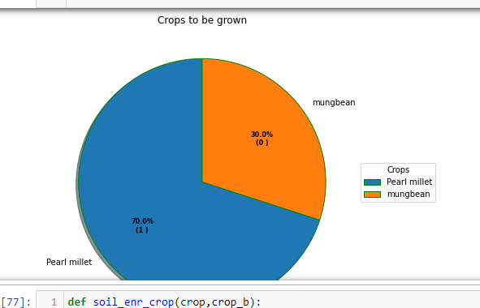
Crops to be grown

Slide 10
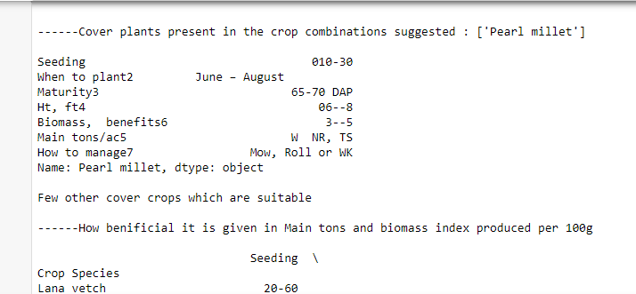
Cover plants

Slide 11
So above mentioned was just for category 1 where the crop and nutrient is mentioned
Now there are many questions which arises
What if ,only soil and season is known --- crop and nutrient to be predicted or
Water limited areas -- such crop and cover crop with best nutrient to be predicted
So this model will be further developed for this category
BUT!! How to manage all the inputs given from a drone etc kind of gadgets There’s an feature in this model which makes a id based file system for each farmer or node , then in that folder contains the json file containing inputs and outputs in each call ---
which can be utilized to ML models
Also track of a farmer will be kept :D
The file uploaded has few other python files , which are used to add more combinations
Nothing is hardcoded !! at least 90%

Slide 12
Images model : this is a side by model which will be used when images are sent by drone
Here i have created my dataset as this wasn't available in json in ready
The approach i have chosen is transfer learning : which uses efficient net , this net is amazing which was developed recently in 2019 - does th job of feature extraction and feature creation
The crops are only 5 and it predicts with 92% accuracy
Advancement to be done : all crops data set , with dataset containing deceased crop

Slide 13
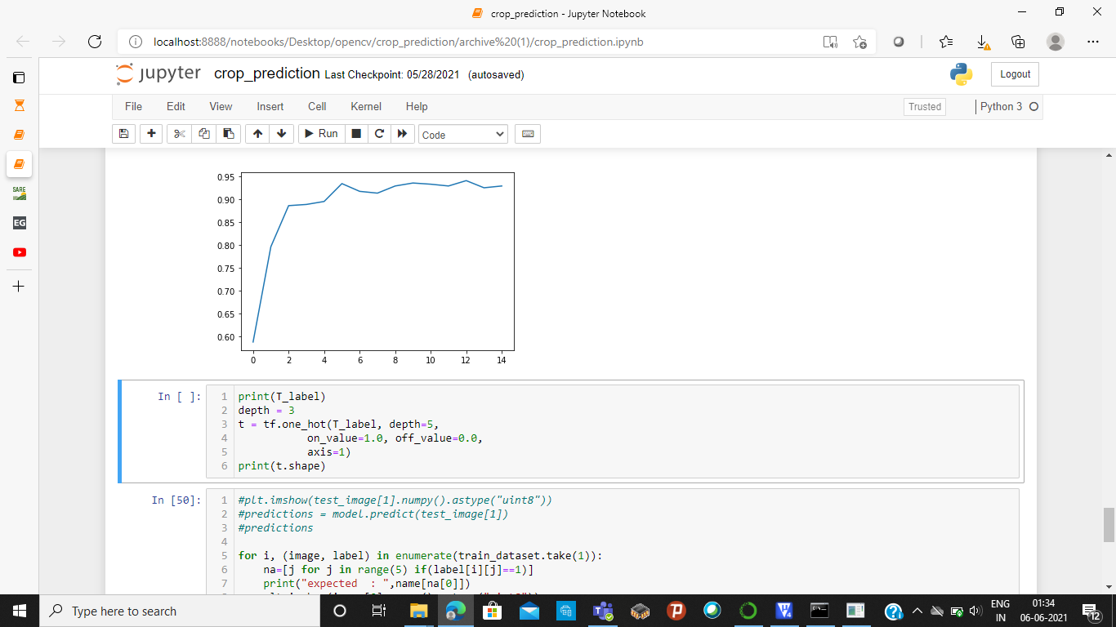

Slide 14
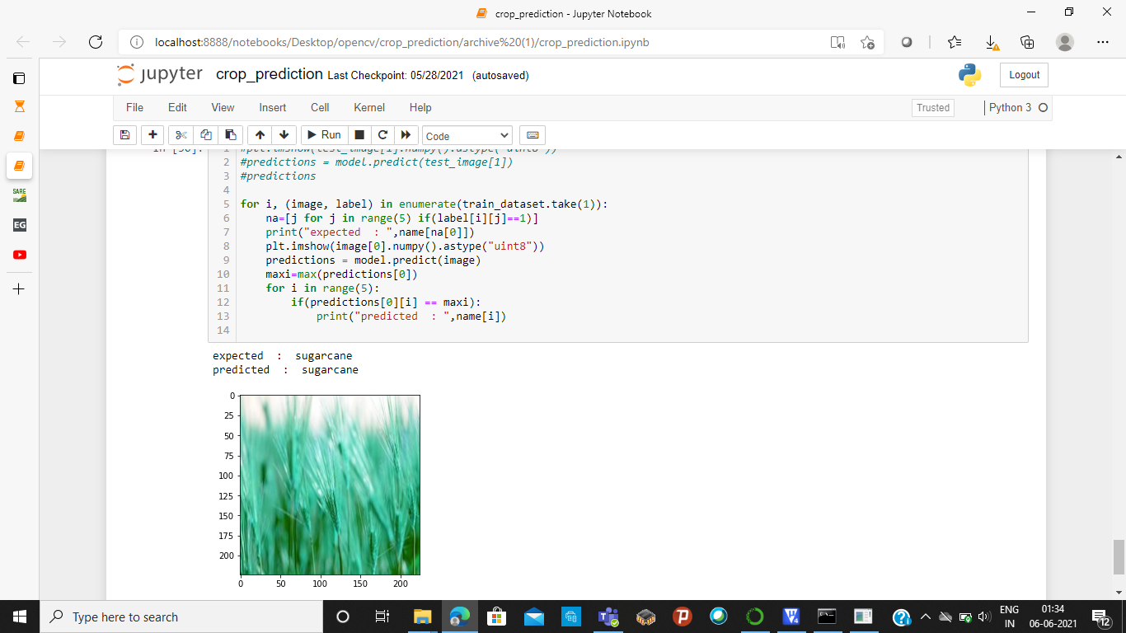

Slide 15
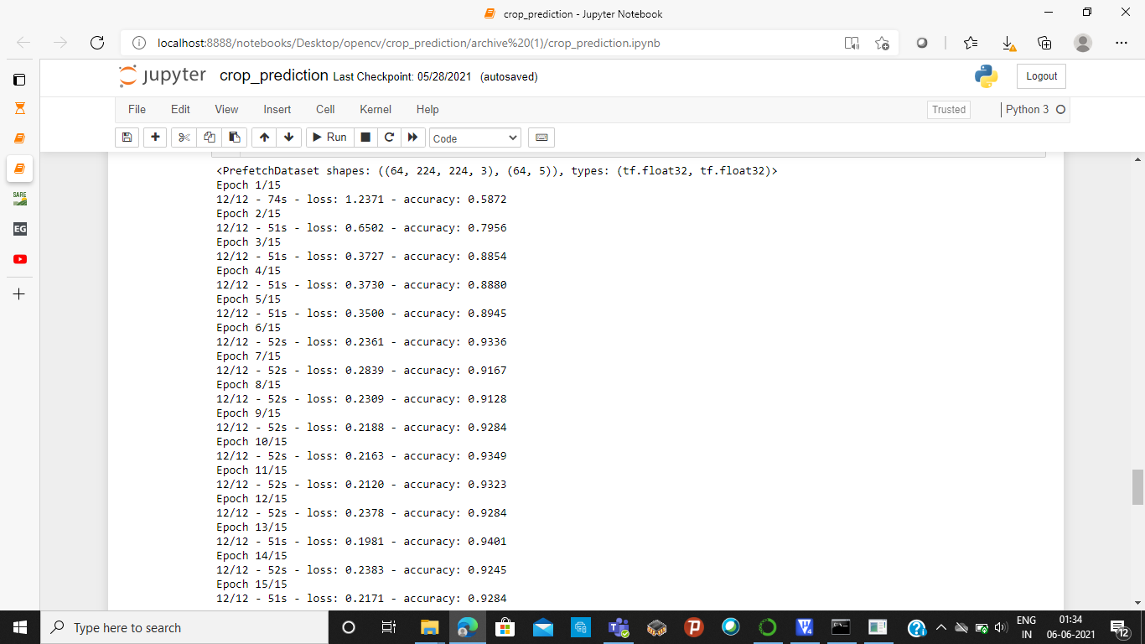

Slide 16
Hardware and communication
I have used gsm to establish tcp/ip connectionbetween the server in the my pc and client itself and to find location
As mine was mobile network i used ngrox for port forwarding .
Rfid for a reason : to handle the number of farmers/ node , the id mentioned in datamodel will be is this rfid
I could not set up this on 4 wheeler i almost ran out of time

Slide 17
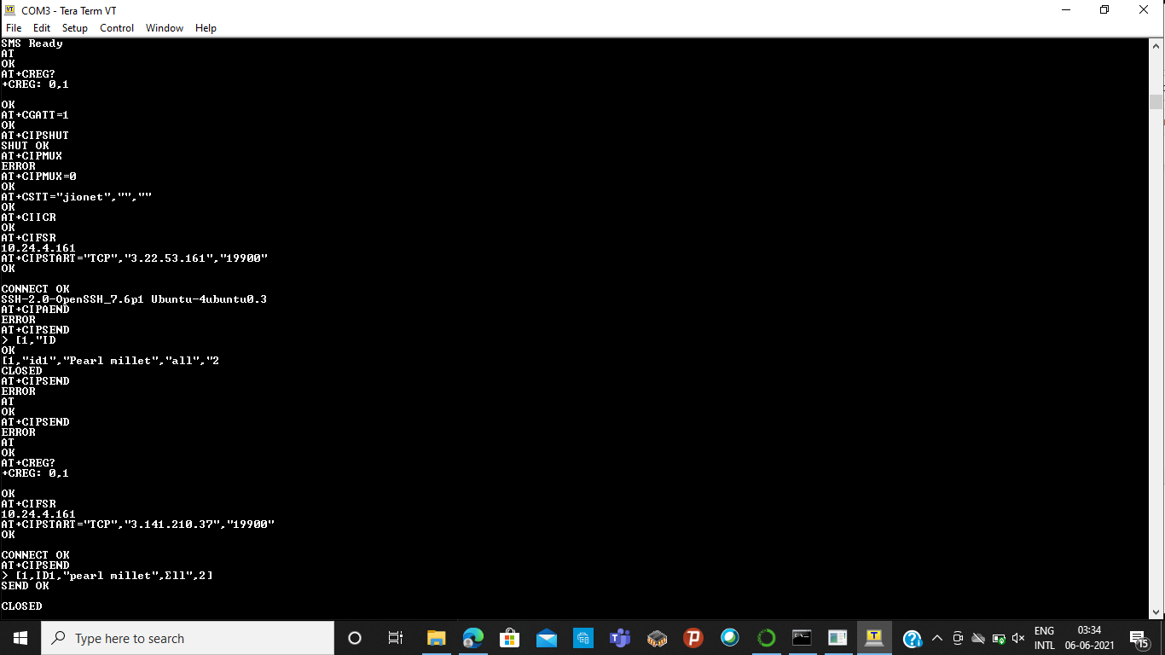

Slide 18
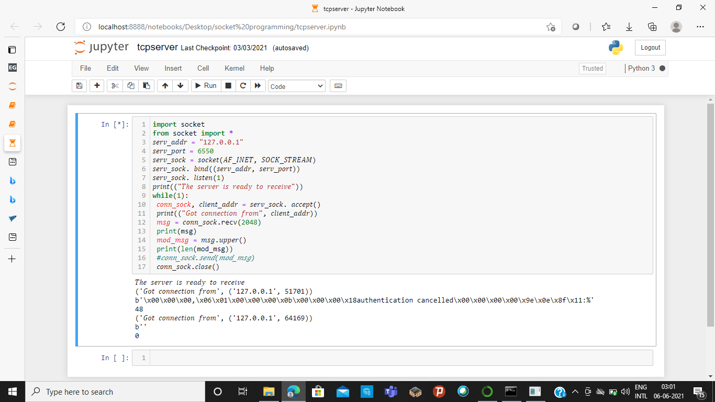

Slide 19
In the screen shot the soket code is seperate , i have added that to my data model .
I could not set up the complete circuit as I left my female and mail connector in hostel : (
BUT i have uploaded the simulated code !!

Slide 20
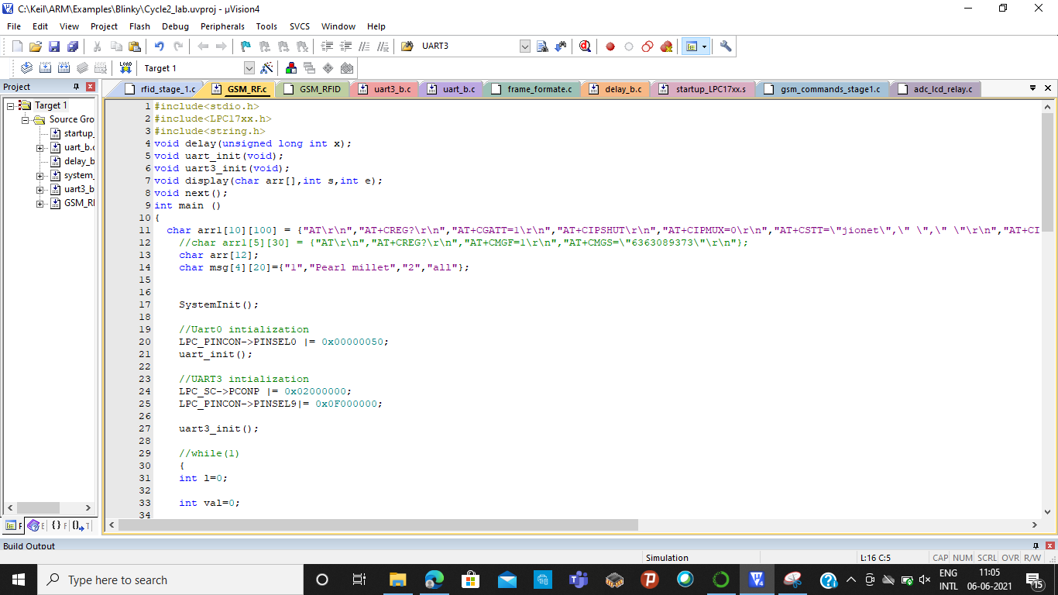

Slide 21
End
I could do all possible things in this 3 days ,
I would like to say i have finished almost 60%
Further will be implemented soon as this is the change i have to see in my life time :D
Thank you

